Slide 1
Kali/Ubuntu linux installation

Slide 2
First we download VM Virtual box
Go to this link : https://www.virtualbox.org/wiki/Downloads
Then click on (Windows hosts) to start downloading for windows
Set up:
Set up is easy just click next until you finish

Slide 3
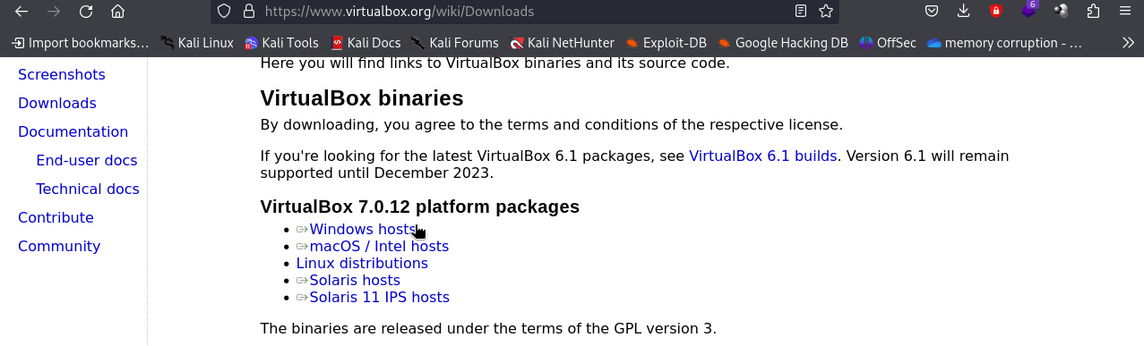

Slide 4
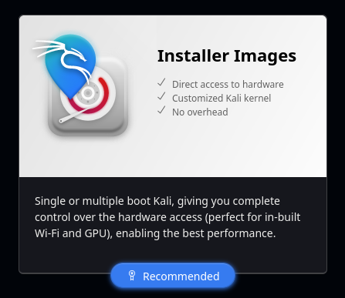
Kali linux iso file installation
Go to this link : https://www.kali.org/get-kali/#kali-platforms
then choose installer image as shown here

Slide 5
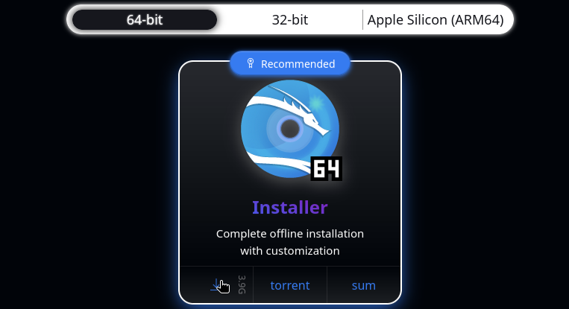
Then choose installer and start downloading:

Slide 6

Setting up kali linux on your device
First click on new at the top:

Slide 7
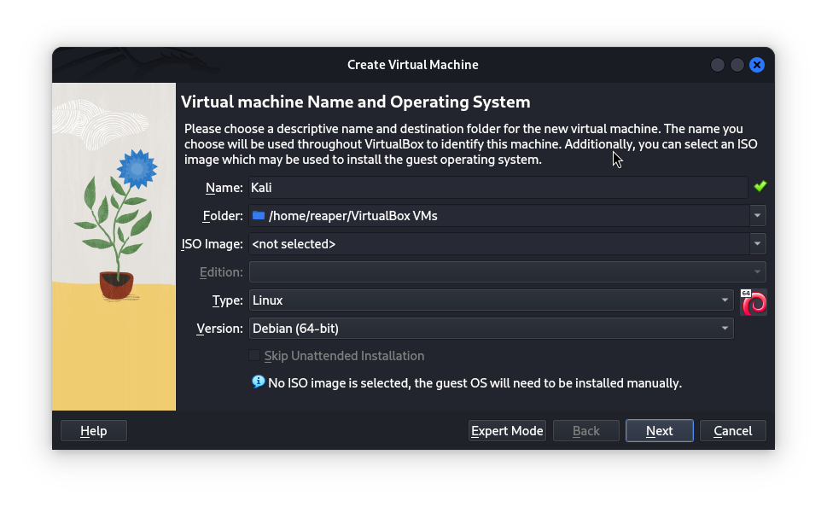
Then name your machine name (whatever name you want) and choose type for (Linux) and Version for (Debian 64-bit)

Slide 8
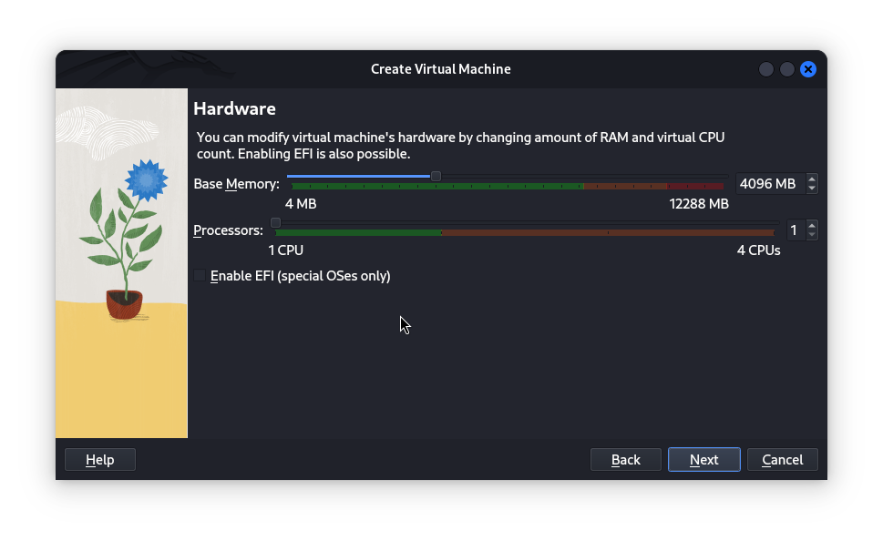
After you press next now customize your hardware specifications
It is recommended to use at least 4096MB for RAM

Slide 9
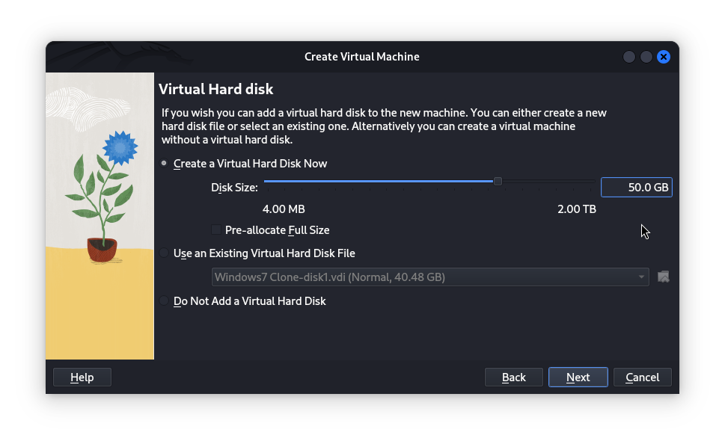
It would be good to choose 50GB as beginning for your hard disk size:

Slide 10
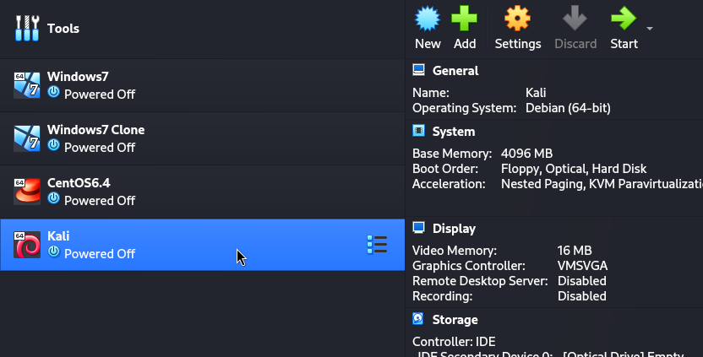
Now choose the machine you made and click on settings:

Slide 11
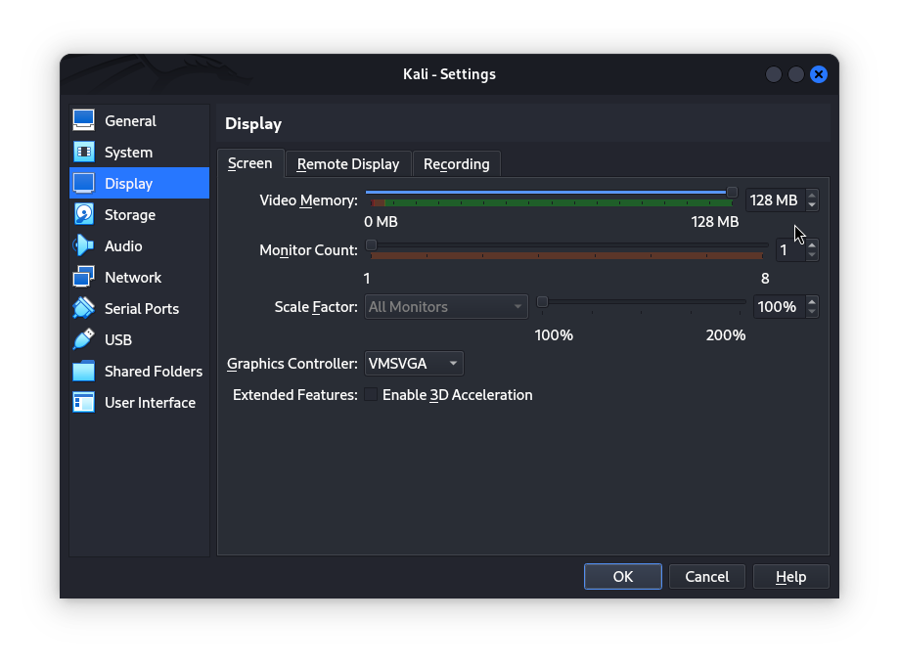
Now choose display and set video memory for maximum:

Slide 12
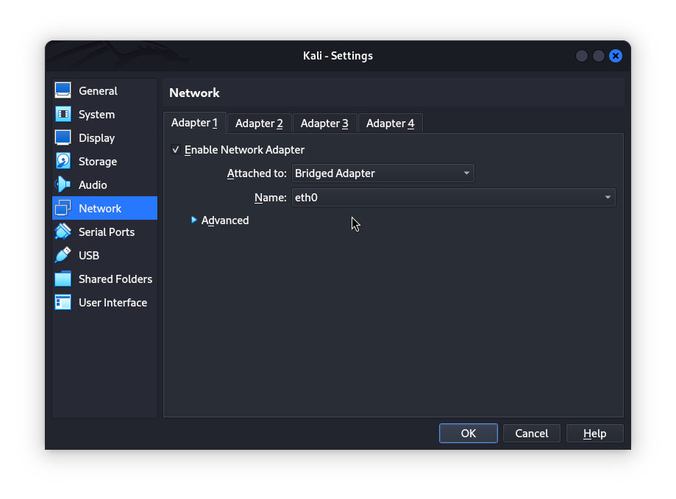
Configure the network now set Adapter 1 as shown ( Attached to -> Bridged adapter) keep the Name at default:

Slide 13
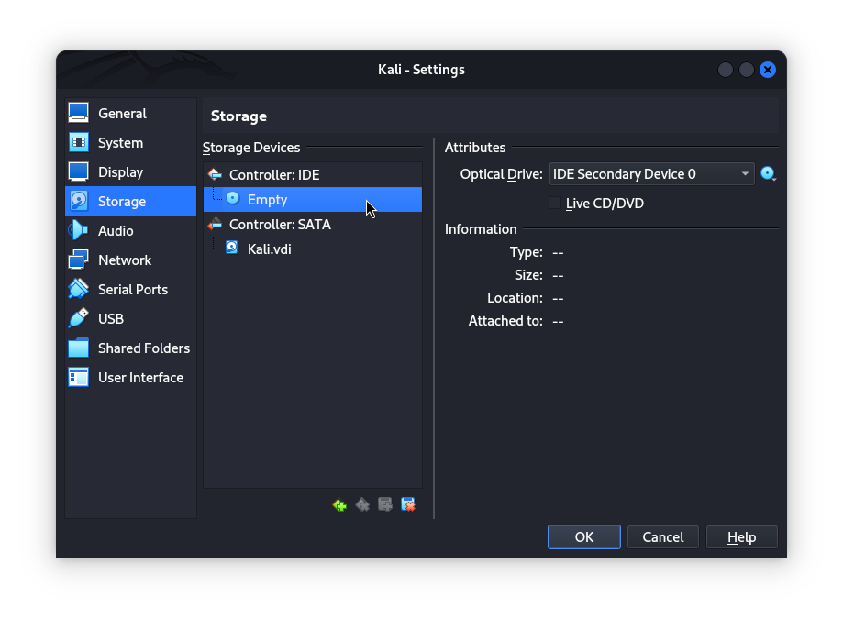
Go to storage click on (Controller :IDE ) and choose empty and click on the disk(shown by the red arrow) then click on (Choose/Create virtual optical disk):

Slide 14
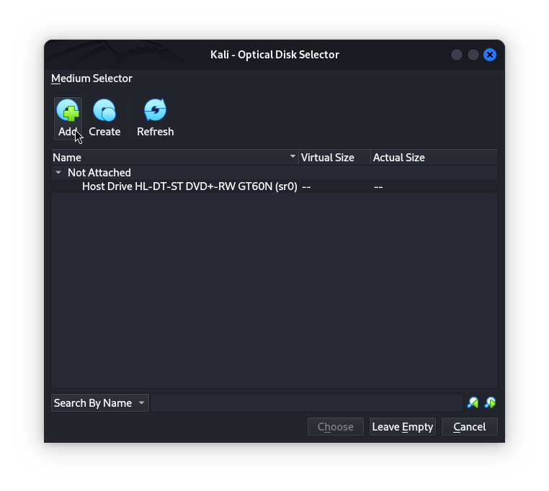
Click on add and choose your ( .iso ) file that you have downloaded before then click on choose:

Slide 15
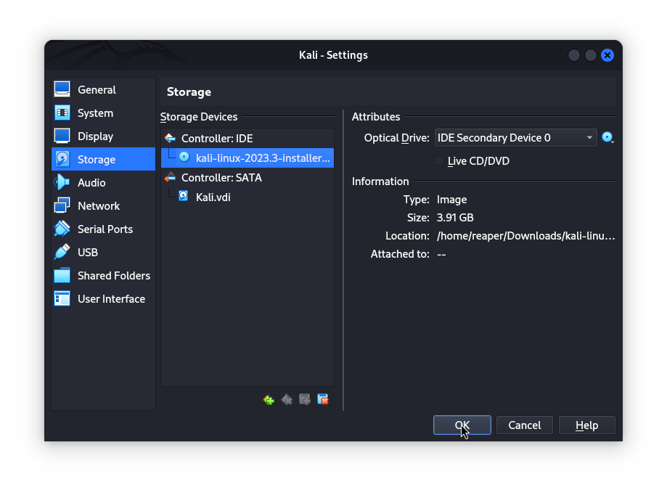
Click on ok then start the machine:

Slide 16
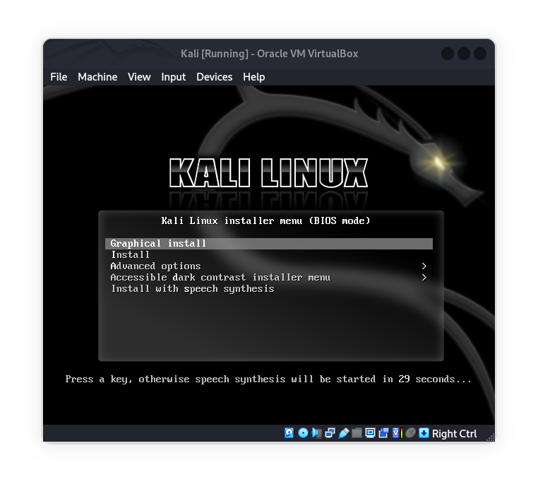
Choose graphical install:

Slide 17
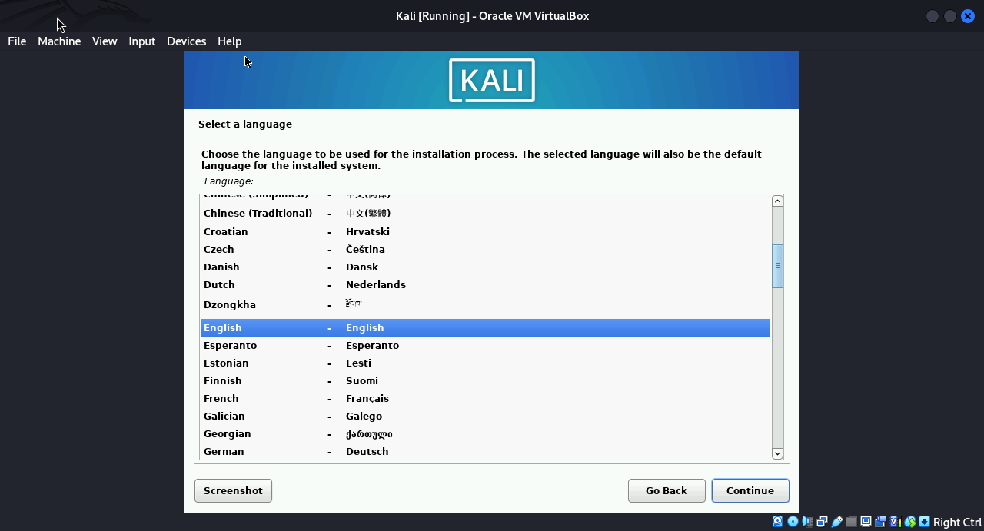
Choose the language and location and keyboard or you can keep it on default:

Slide 18
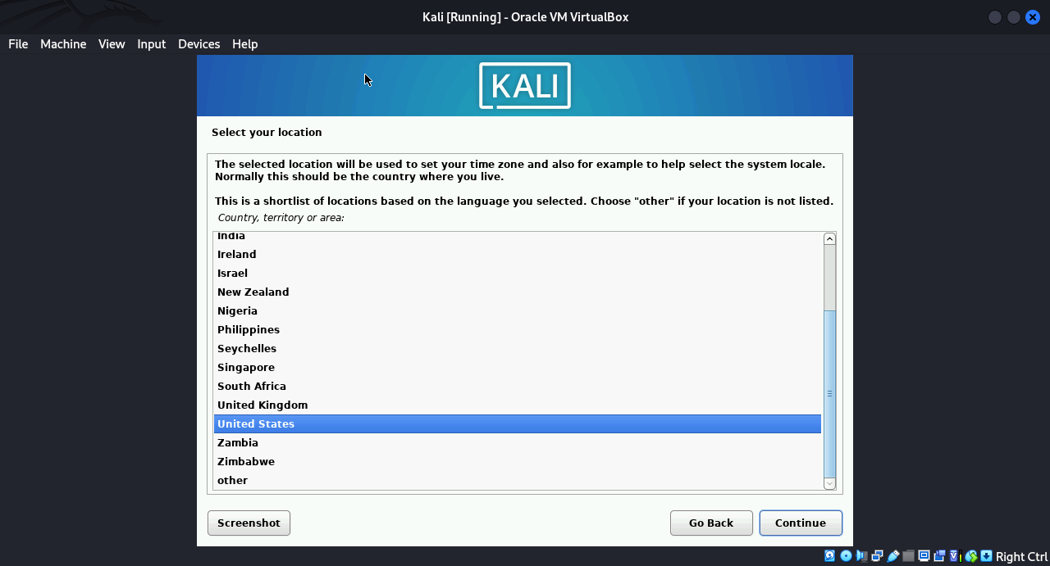

Slide 19
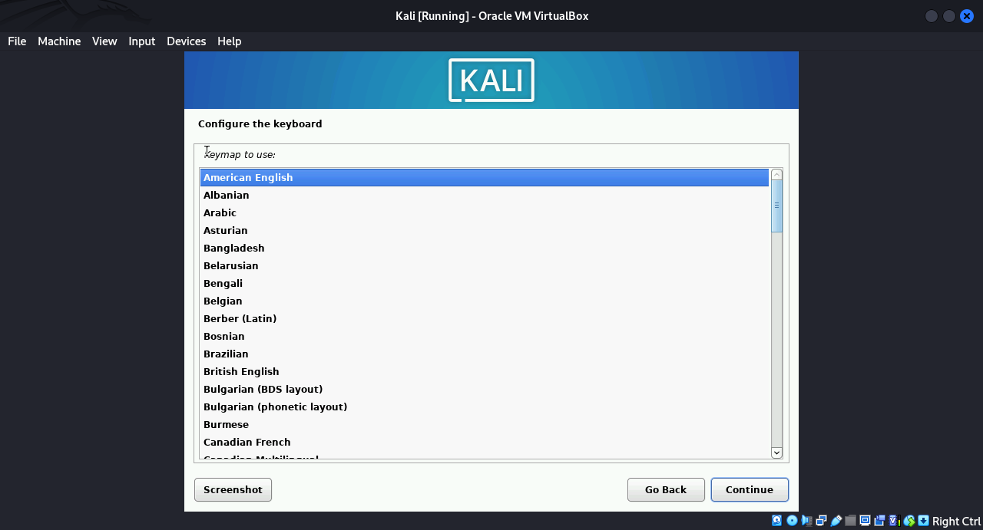

Slide 20
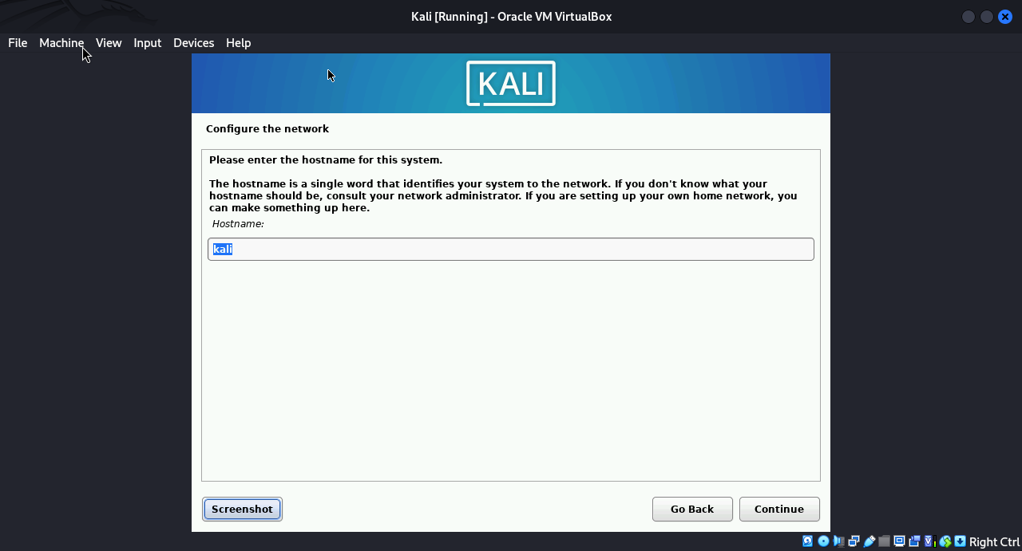
Now choose a name for your machine:

Slide 21
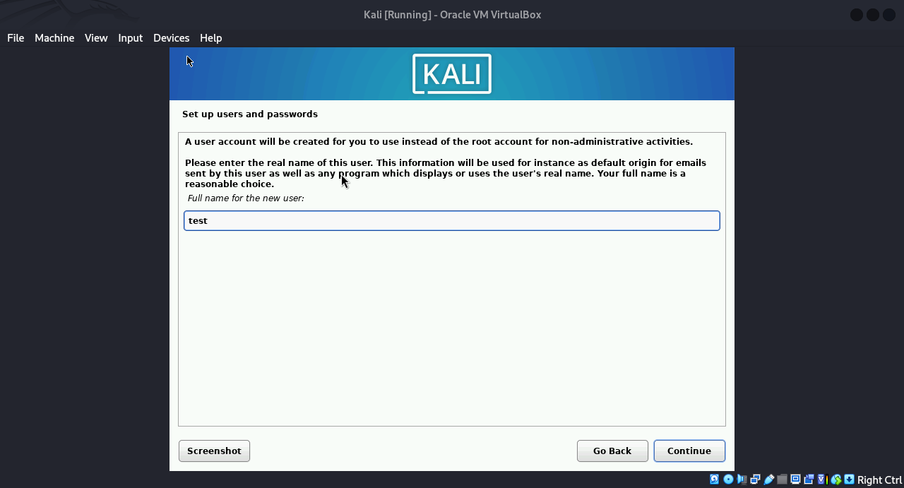
Set the full name also it not necessary to set your real name:

Slide 22
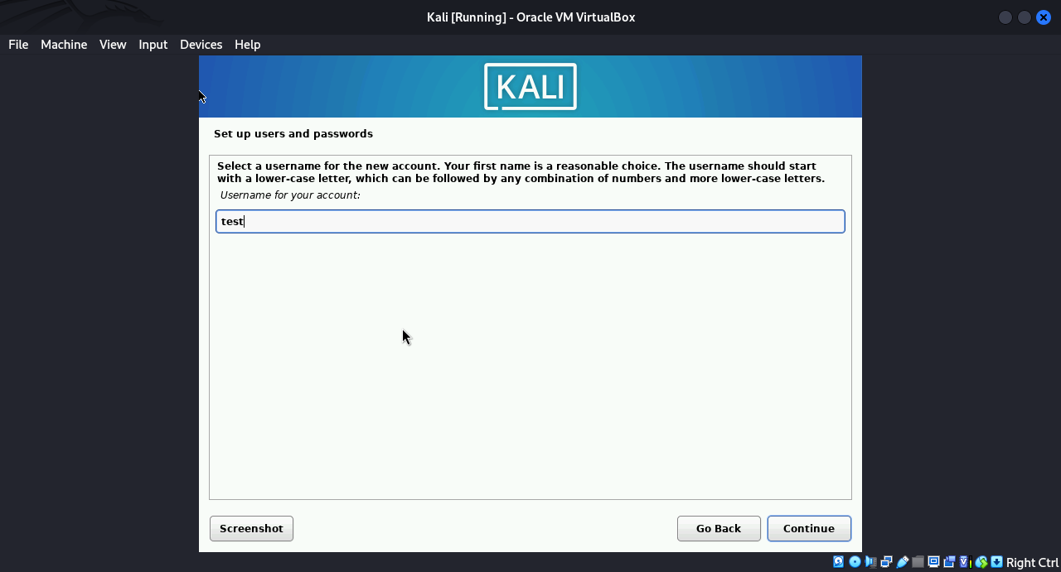
Set what ever username you want (it must be less than 32 characters)

Slide 23
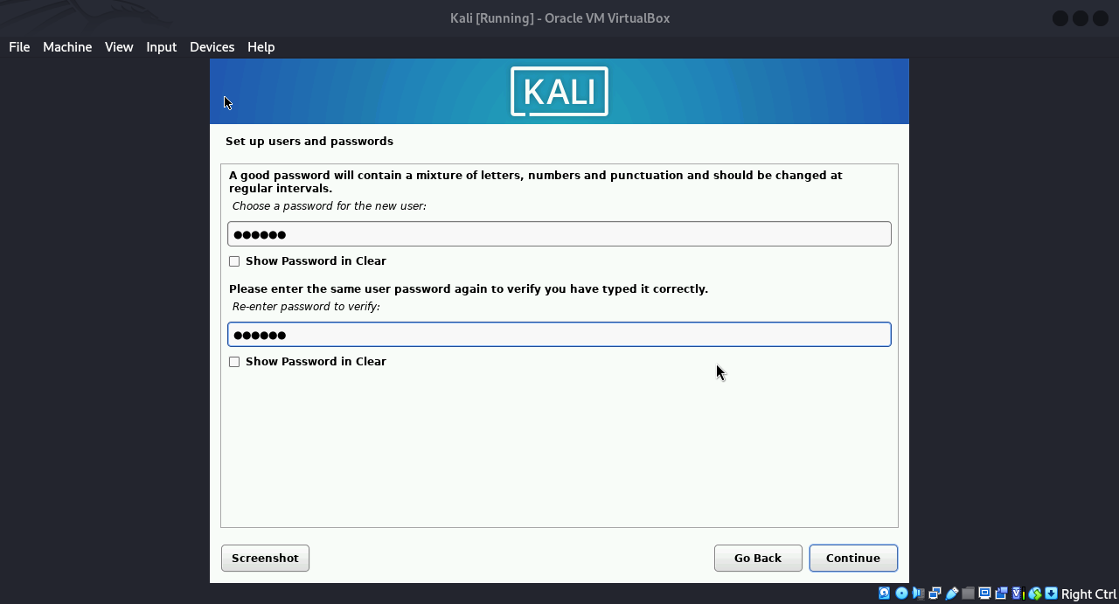
Set your password:

Slide 24
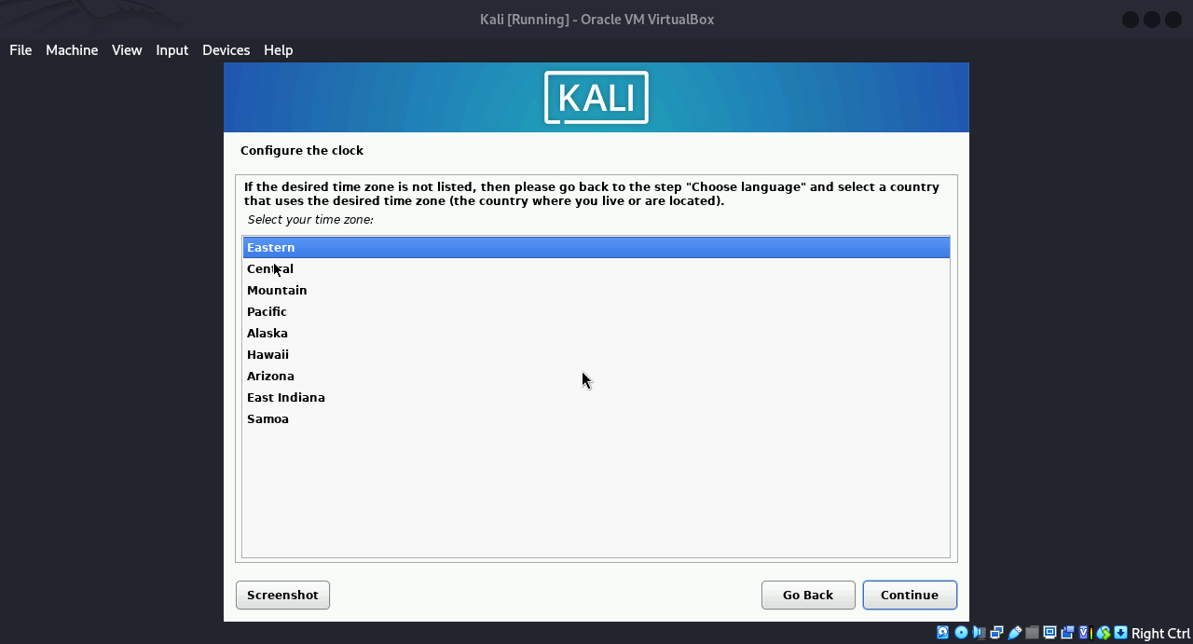
This is for clock configuration it is not necessary keep it on default:

Slide 25
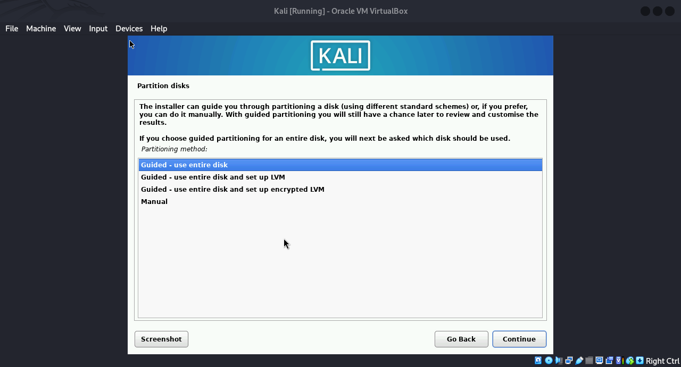
Disk partitioning (dividing the disk into parts) keep it on default for now:

Slide 26
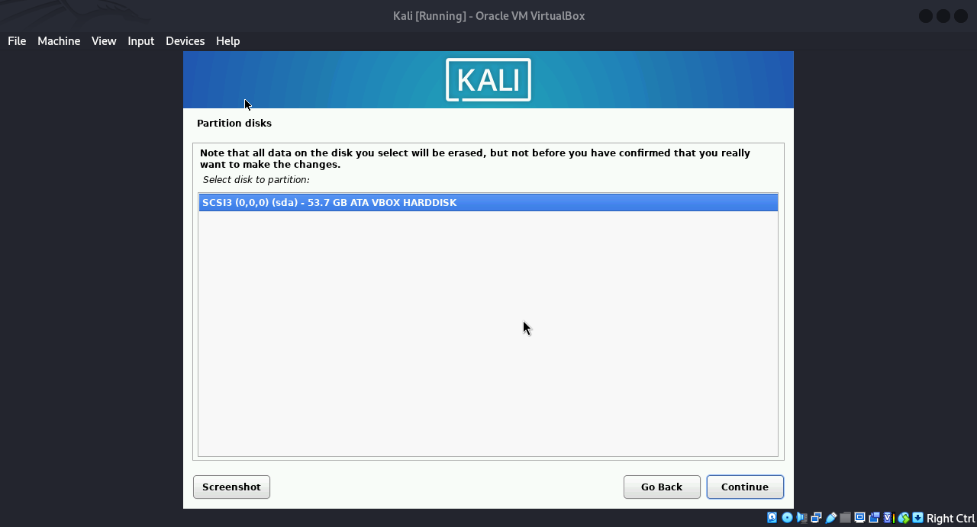
Continue:

Slide 27
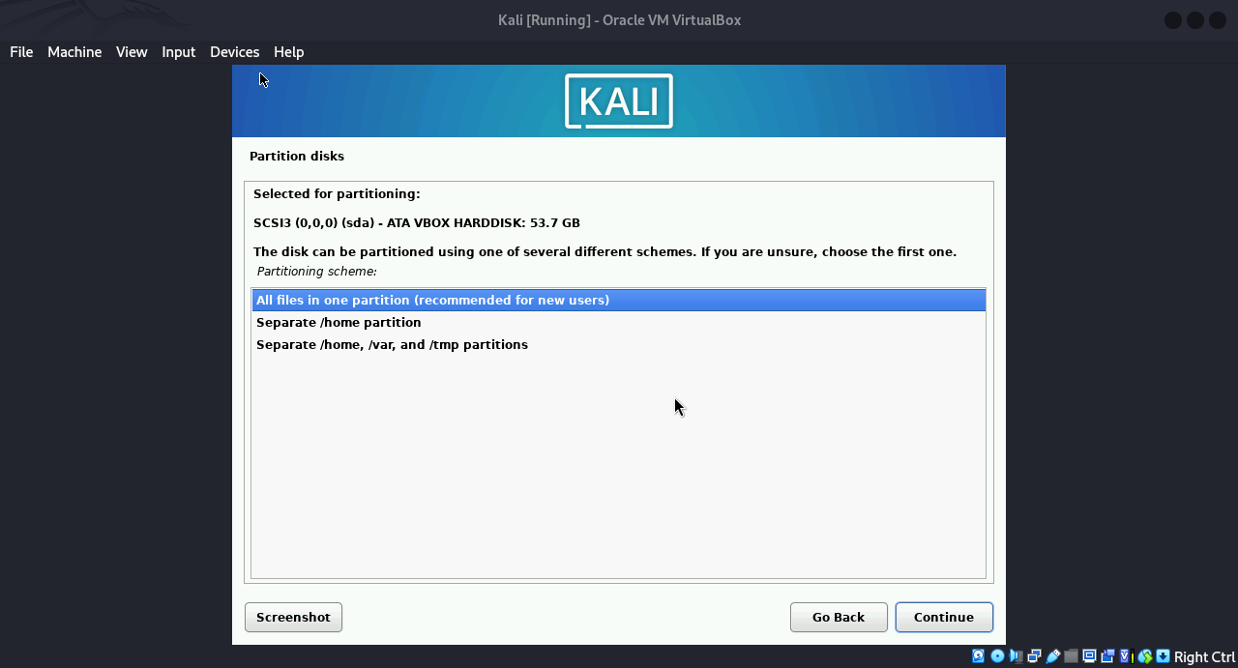
keep this on default you can partition your disk as you want after you get more familiar with linux:

Slide 28
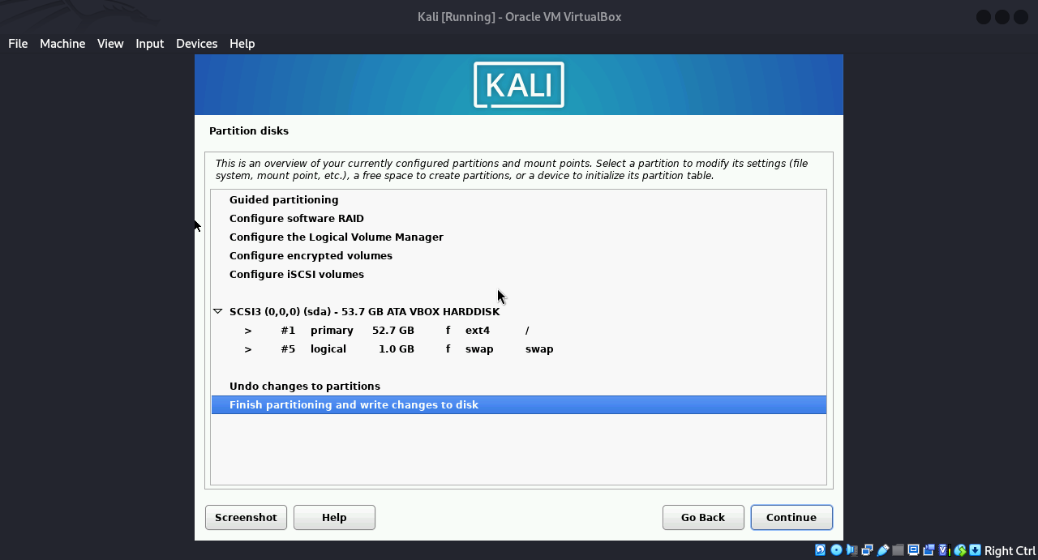
Click on (Finish partitioning …)

Slide 29
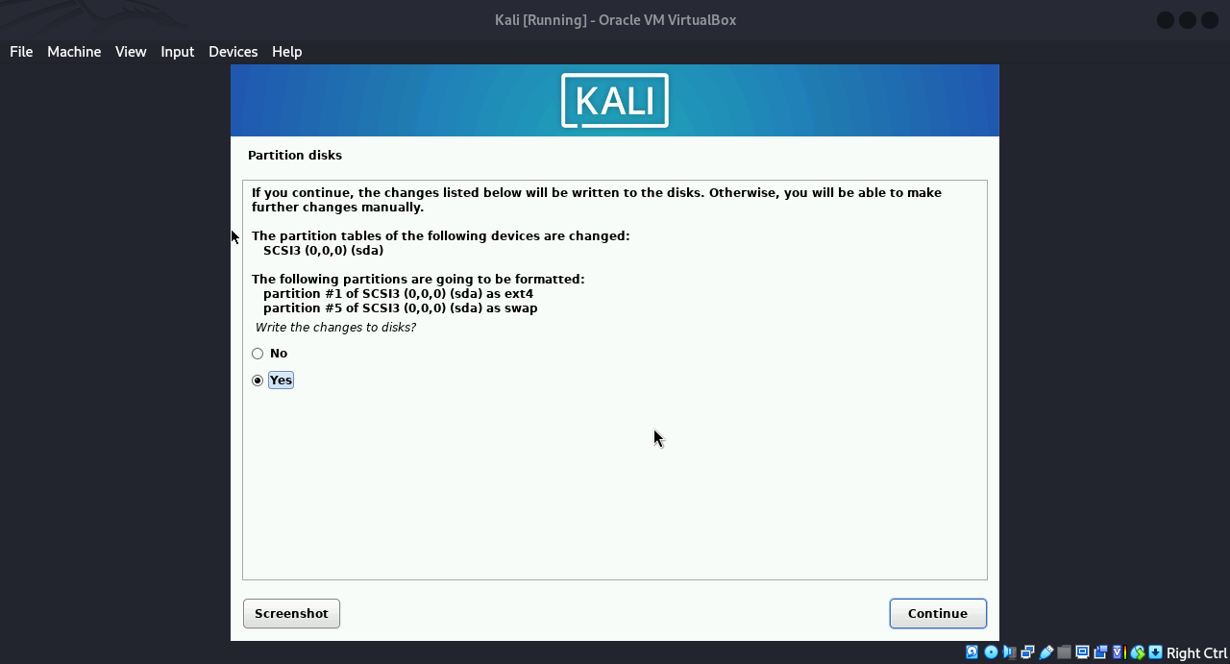
Click on yes to save the changes then continue:

Slide 30
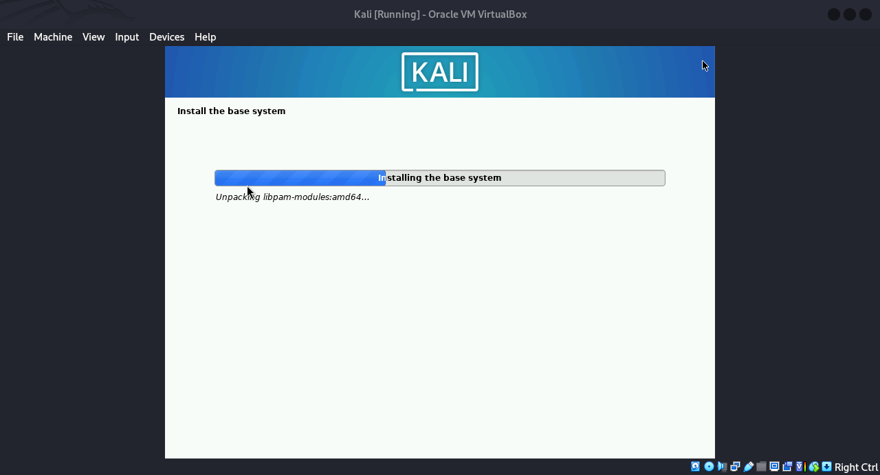
Wait for it until it finishes the base system installation:

Slide 31
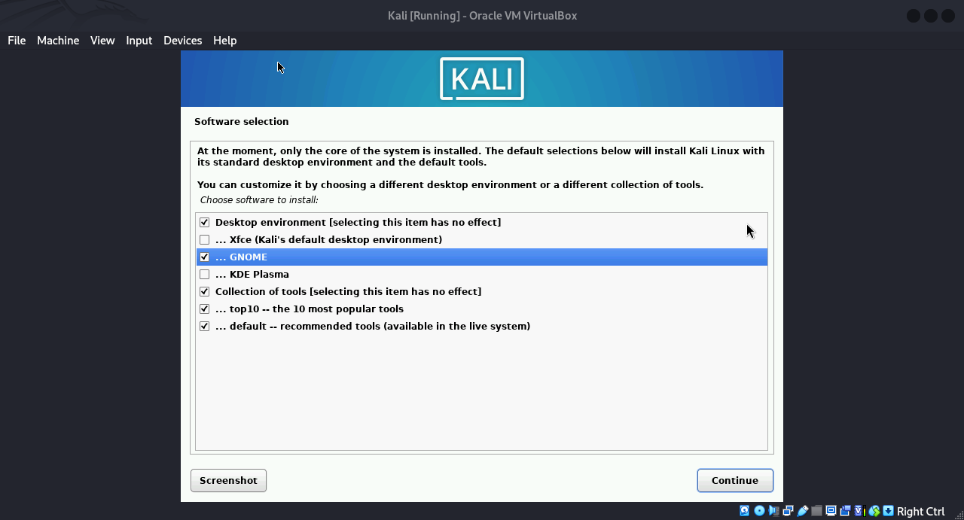
Unselect (Xfce) it is chosen by default and select GNOME (For better interface) then continue:

Slide 32
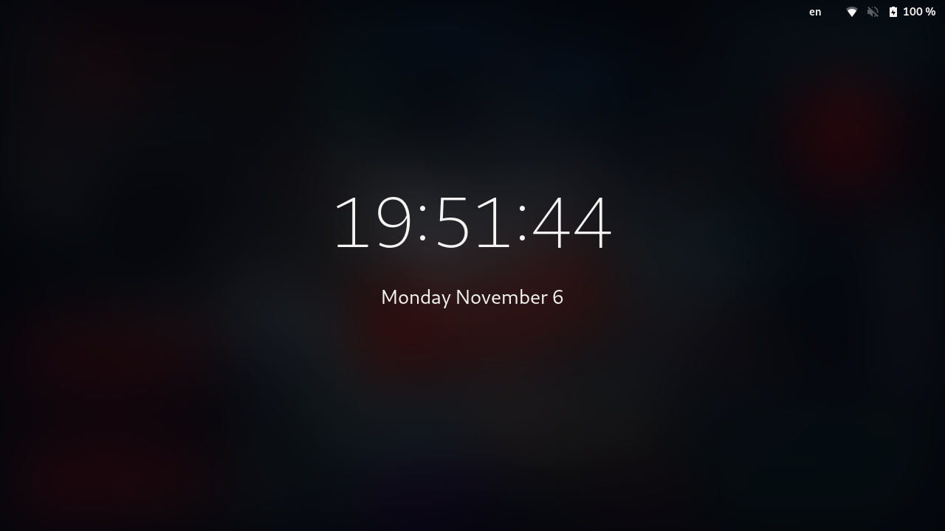
This is the interface after you complete the download now press (Enter):

Slide 33
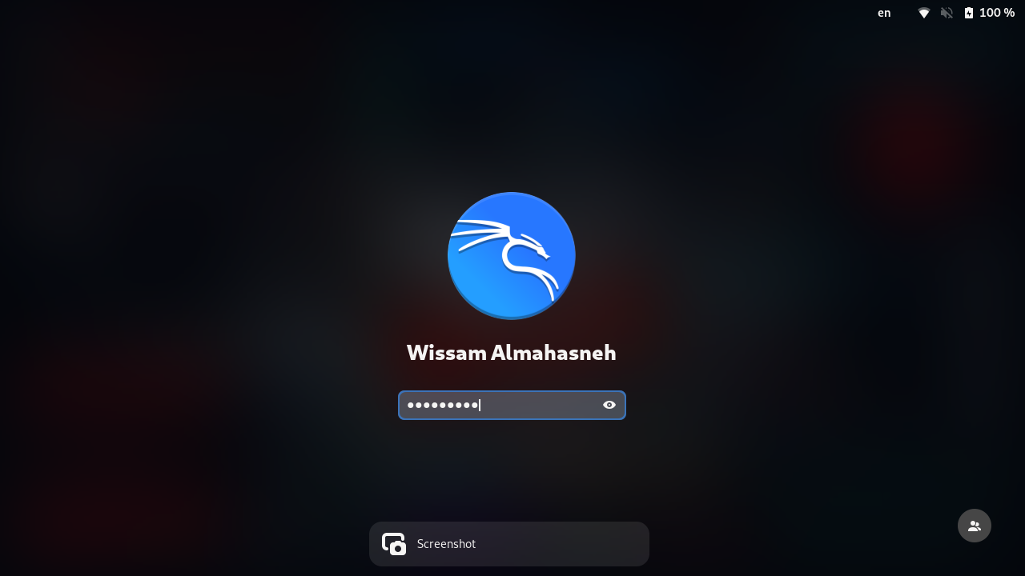
Enter your password (the password you used in the set up) and welcome soldier you are now Linux user :)

Slide 34
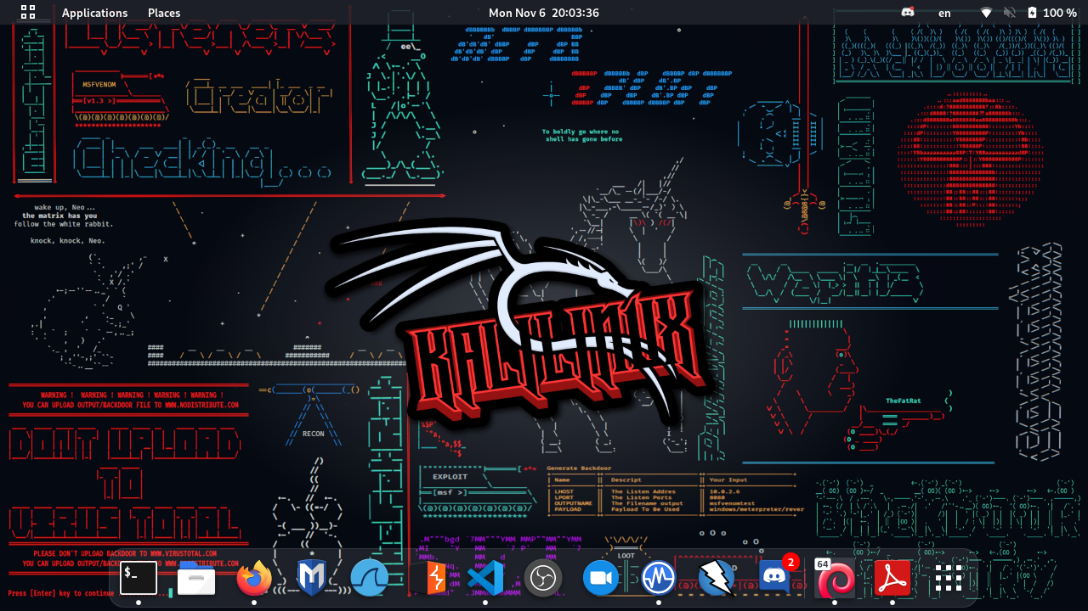
This is the first thing you will see you can change your linux background like I did:

